Slide 1
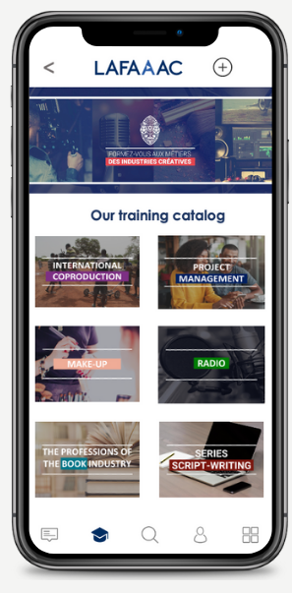
The digital Platform
that trains people in the creative industries in Africa

Slide 2
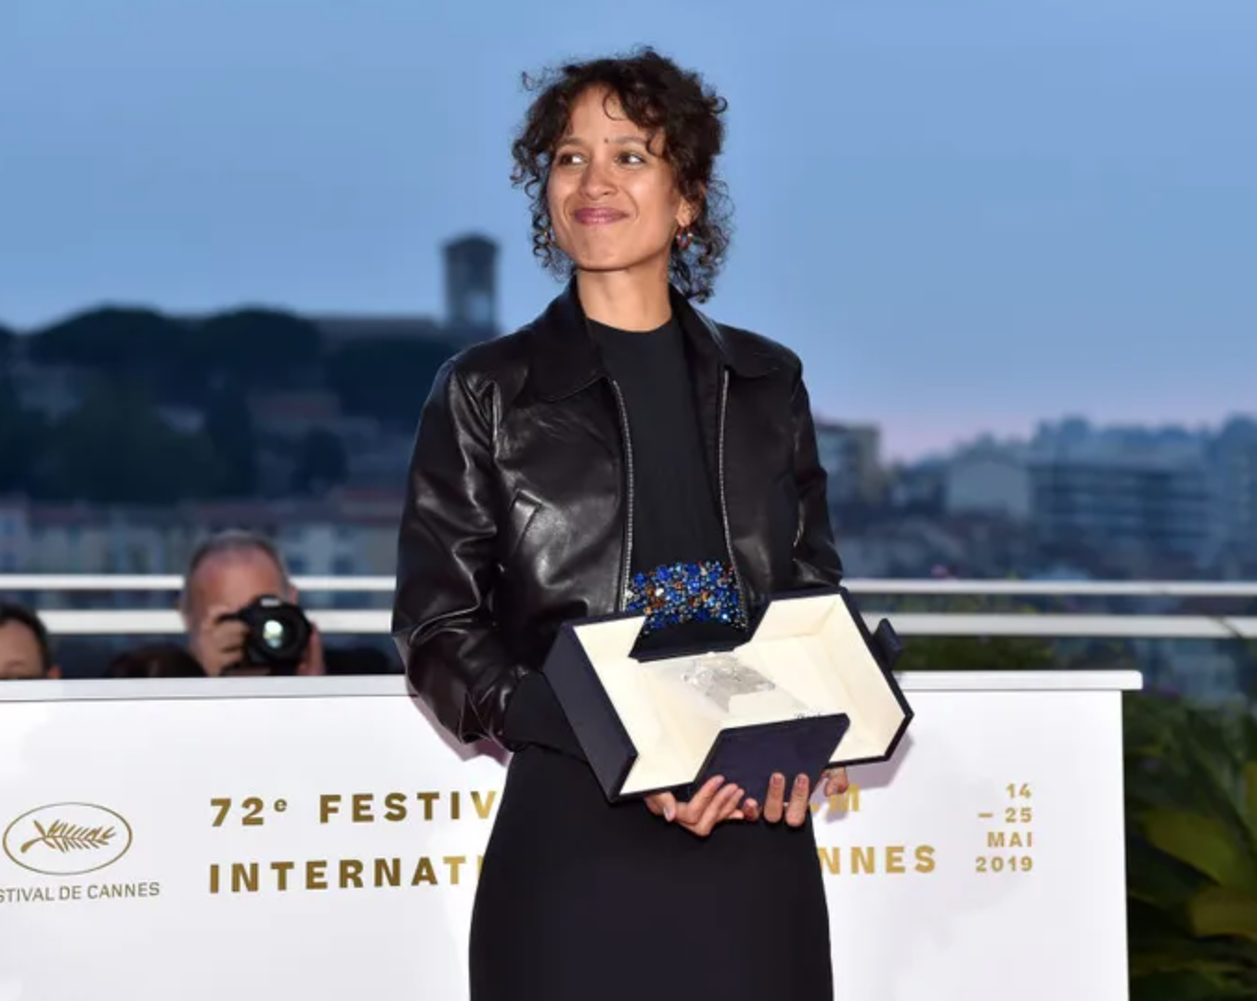
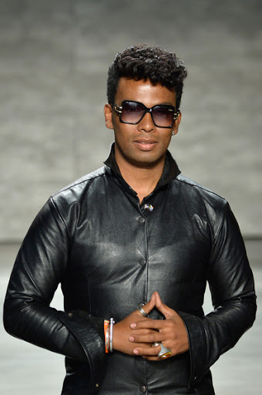
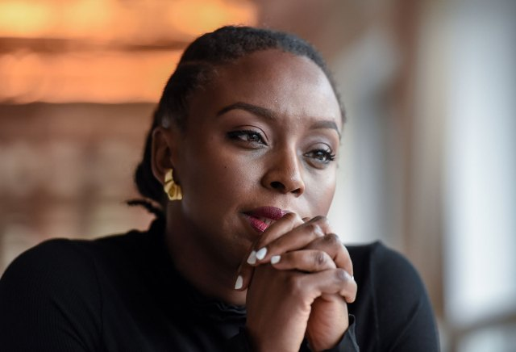
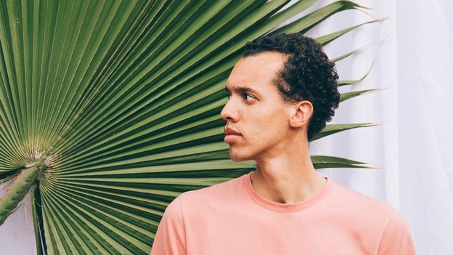
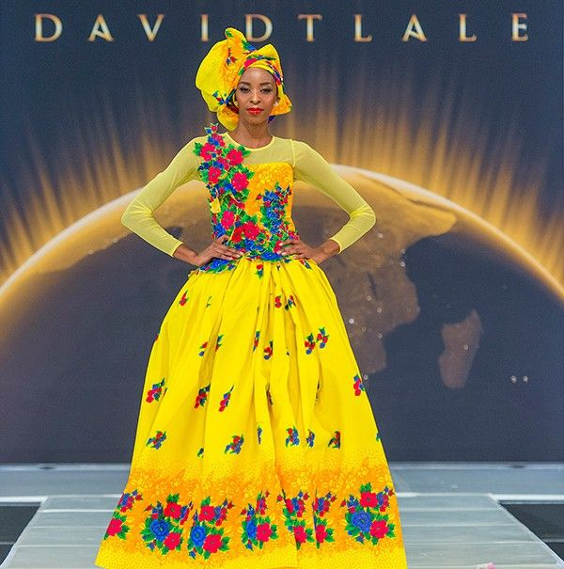
Introduction
African cultures are so abundant and diverse, they are simply asking for exportation...
Fatou N'diaye,
Sénégal
Mati Diop, Sénégal
Grand Prix, Festival de Cannes 2019
Burna Boy
Wizkid
Nigéria
Nigéria
David Tlale,
Chanteurs Pop
Afrique
du Sud
Actrice internationale
et mannequin
Écrivaine
engagée
et universelle
Blick Bassy,
Cameroun
Gaël Faye,
Rwanda
Ecrivain,
Auteur- compositeur, musique
Soul,
hip-hop
Designer à l'international
Chanteur,
guitariste,
compositeur
Chimamanda
Ngozi Adichie,
Nigéria

Slide 3
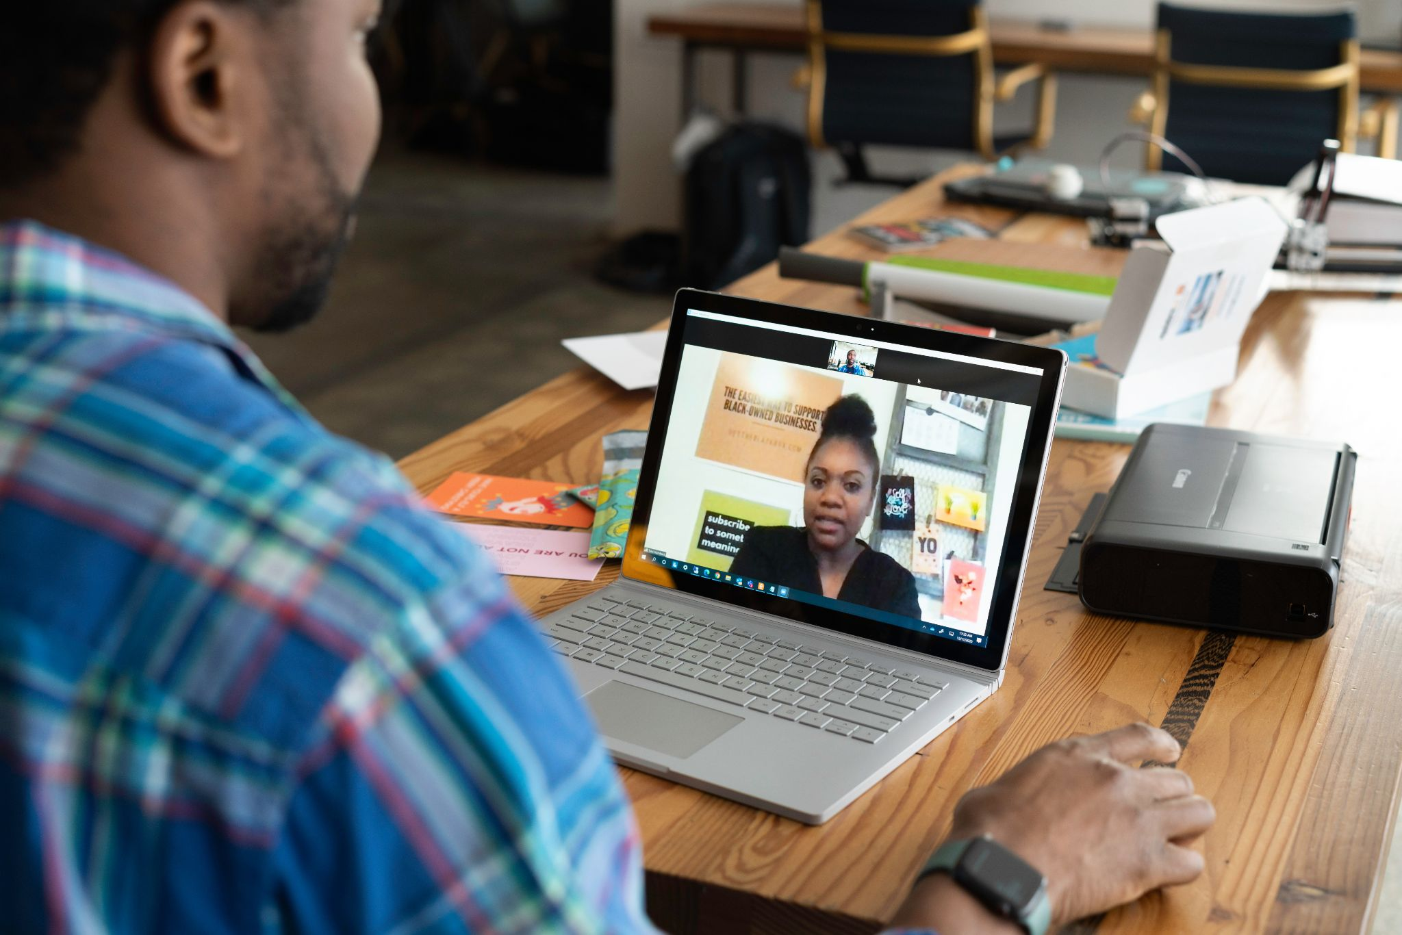
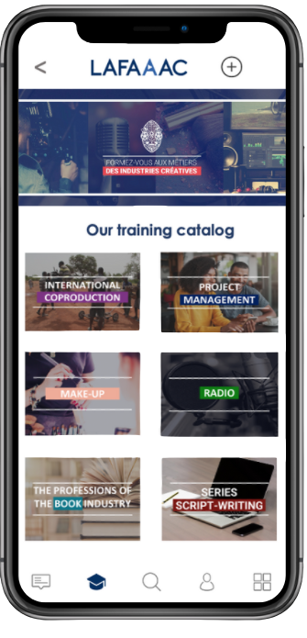
The solution
LAFAAAC is a blended-learning plateform adapted to the needs and uses of our learners.
Learn on mobile
Practice in a virtual class + pratice in person
Free app
Accessible without Internet connexion
Content produce with African partners
+
+
Selection of learners who followed the mobile training
Concrete practice of skills
Designed and delivered in Africa by the best schools and professionals in Europe and Africa
Courses between 4h et 8h on mobile
50 hours of training divided between virtual and face-to-face classes

Slide 4
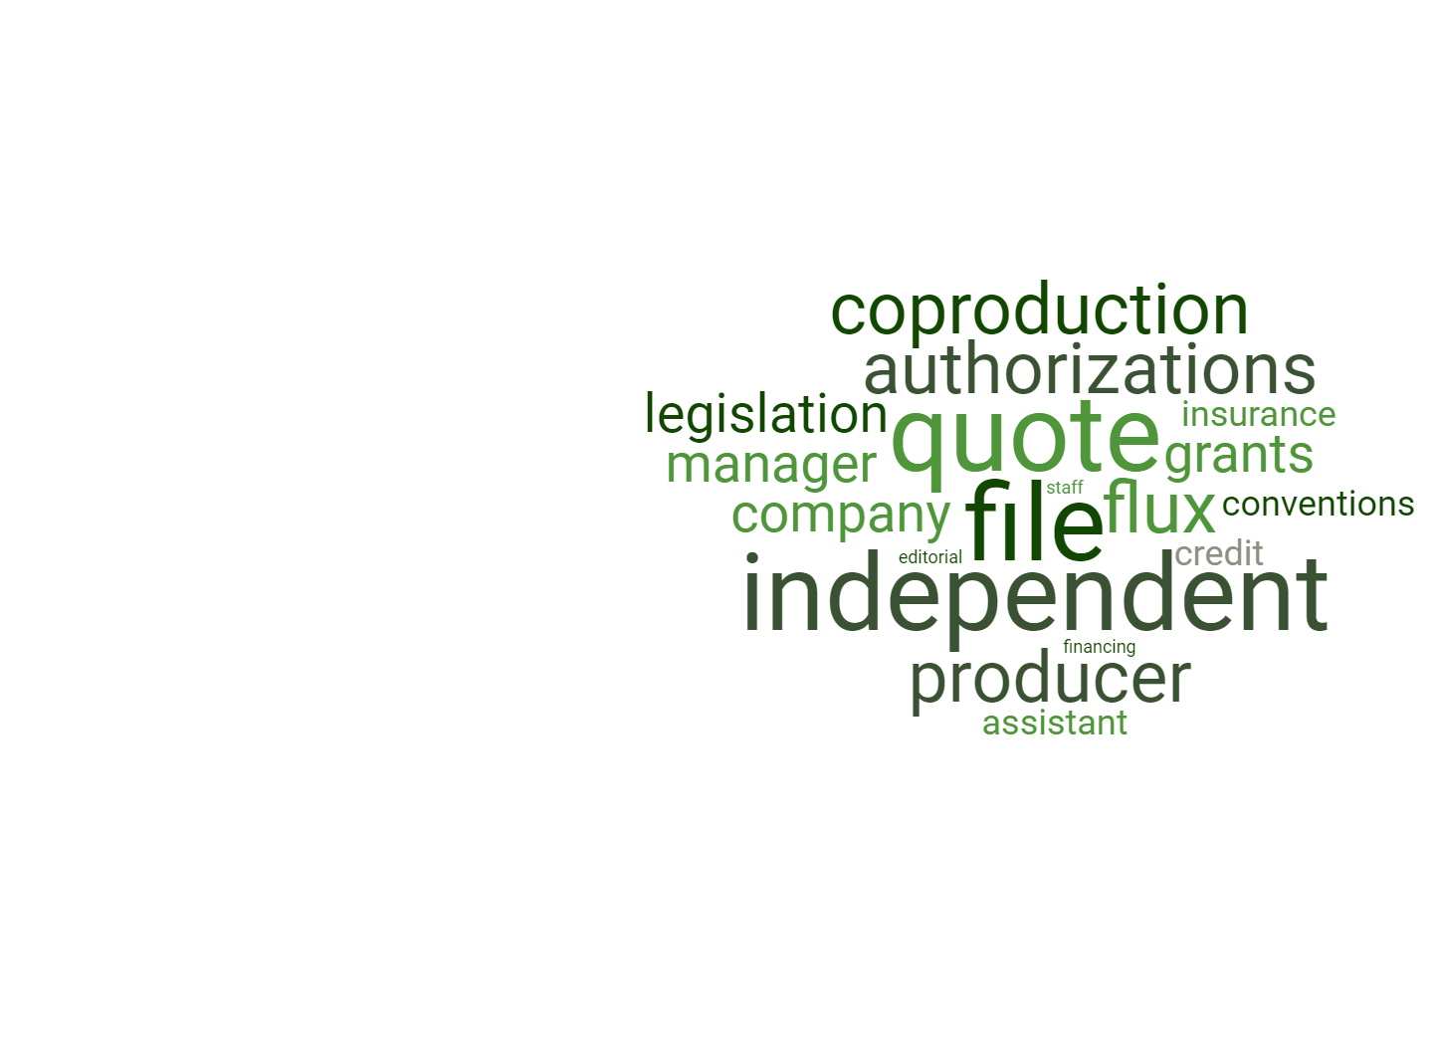
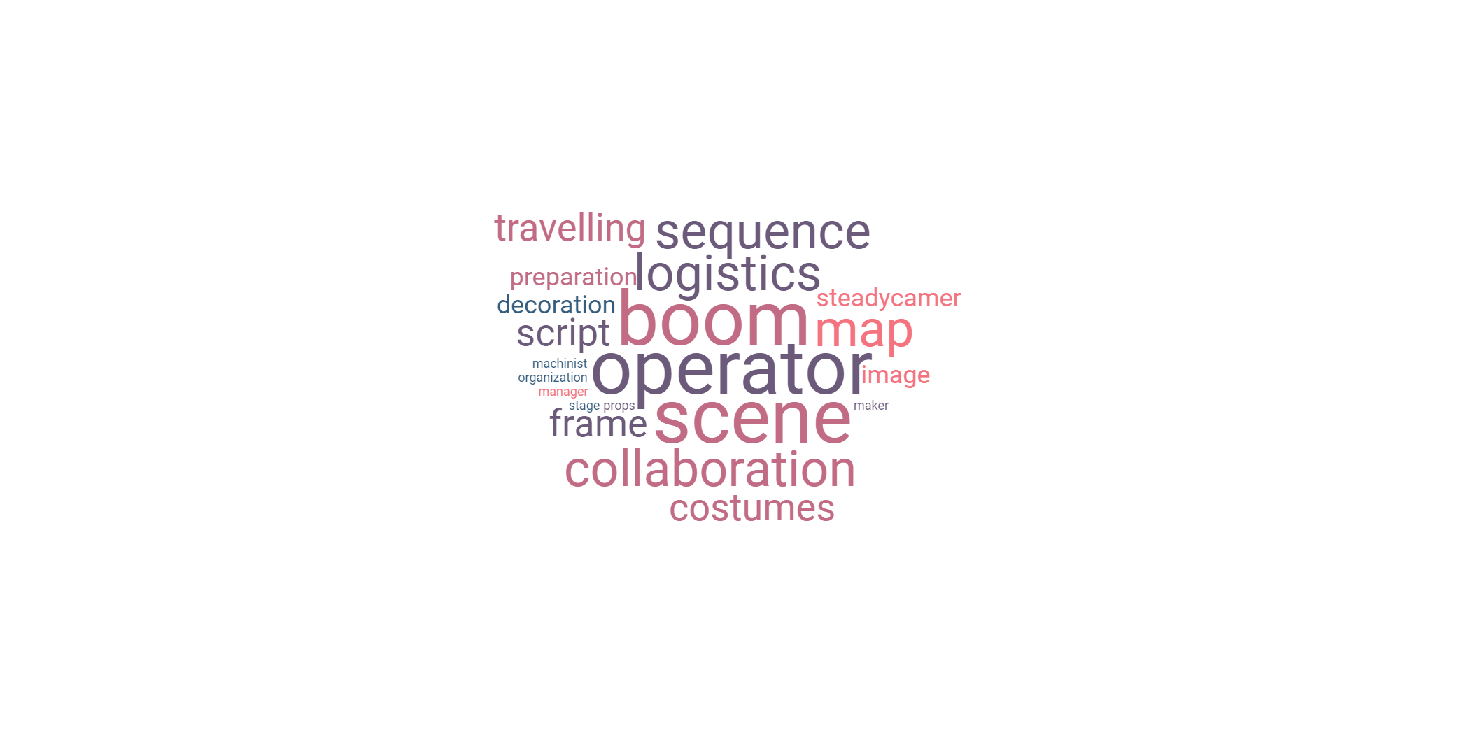
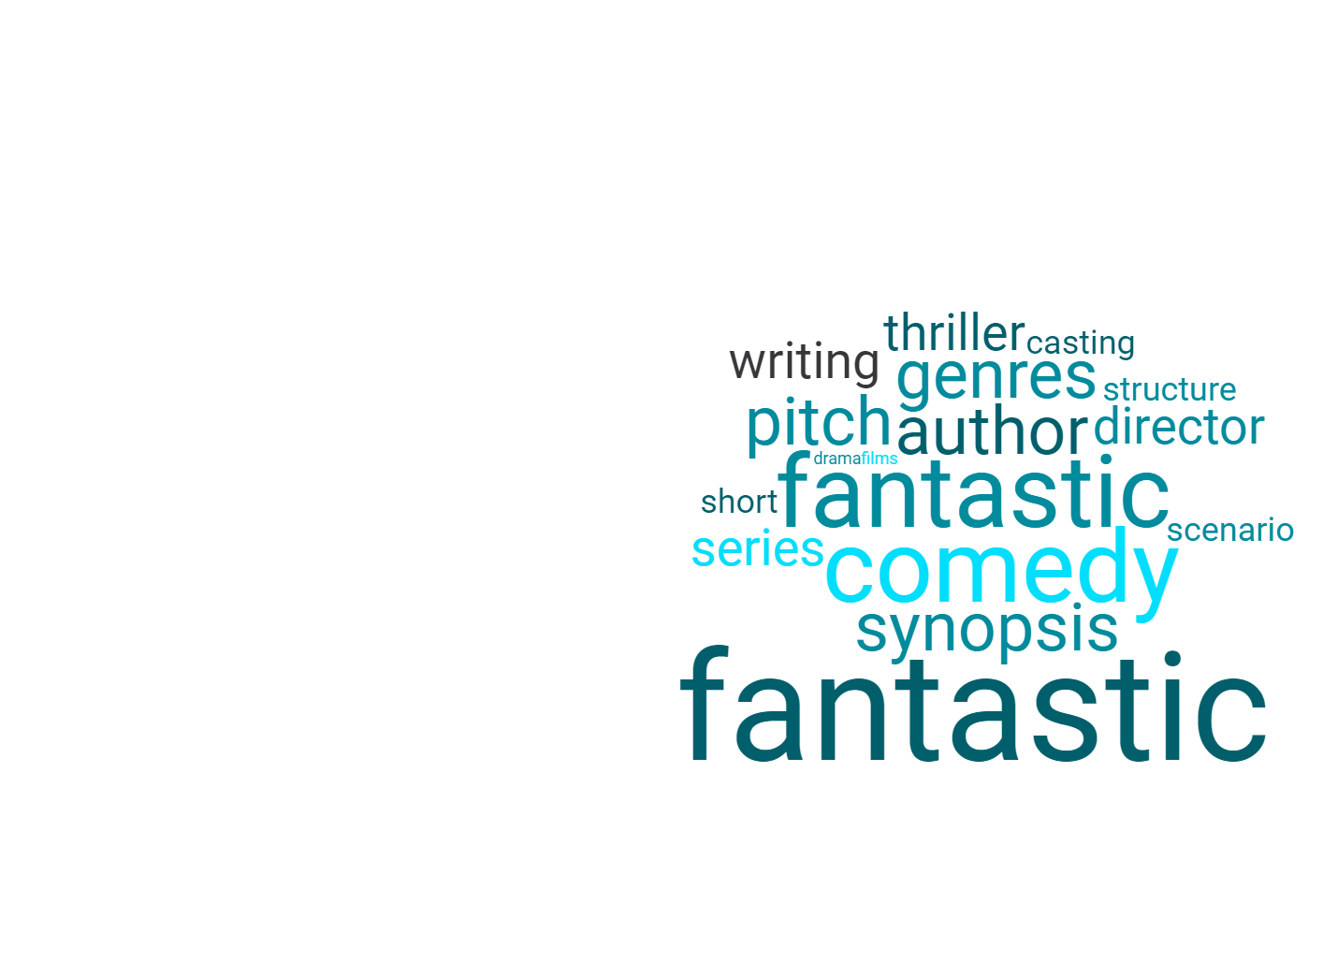
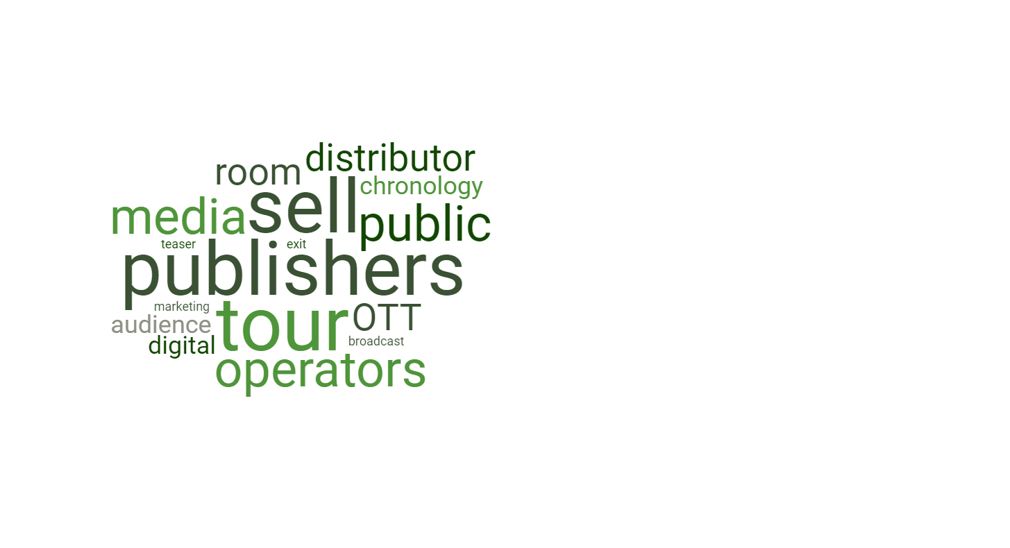
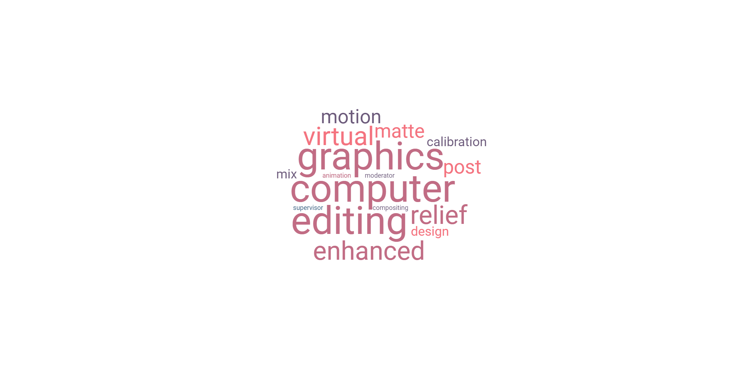
Our training
Creative Industries Occupations
Firstly, the audiovisual sector (radio, TV, cinema, web), covering the field of news, docu, fiction, entertainment; and all professions (artistic, editorial, technical, managerial), then the sectors of publishing, video games, music, animation....
Focus on skills
These courses aim to acquire diversified skills, both professional and soft skills, enabling the employee to adapt to changes affecting his or her profession.
An agile response to the needs of our target group: professionals who wish to broaden and/or deepen their skills and have difficulty accessing training.

Slide 5
Our training
Creative Industries Occupations
Firstly, the audiovisual sector (radio, TV, cinema, web), covering the field of news, docu, fiction, entertainment; and all professions (artistic, editorial, technical, managerial), then the sectors of publishing, video games, music, animation....
Focus on skills
These courses aim to acquire diversified skills, both professional and soft skills, enabling the employee to adapt to changes affecting his or her profession.
An agile response to the needs of our target group: professionals who wish to broaden and/or deepen their skills and have difficulty accessing training.
… very soon in the fashion industry, cultural entrepreneurship and animation !

Slide 6
Pedagogical Protocol - Step #1
• We gather on our platform 100% digital training courses covering the fundamentals of each subject, each skill, to prepare for jobs.
• These professional training courses deal with the global and theoretical framework, situational and behavioral intelligence, in order to support the learner in his understanding of the job and his ability to see him/herself into it.
• These training courses are punctuated by memory games and frequent tests.
• The several-hour training courses are transmedia (text, video, sound, image) and, based on reverse pedagogy.
• Learners are autonomous, and access to the course is via a dedicated mobile app, which can be used without an internet connection, or via webapp.
• At the end of the mobile courses, learners obtain certificates of completion.
STEP #1
A training library
online
accessible on mobile and offline
Learn

Slide 7
Pedagogical Protocol - Step #2
• On the basis of the 1st step, we propose an appropriation of the main notions through tutorials, to be carried out autonomously, but supervised by distance trainers.
• This training program focuses on the acquisition of skills and the realization of exercises, practical cases and short personal projects.
• The Learner’s work is monitored and evaluated at a distance by experienced trainers via virtual classes and the collaborative space on our platform.
• Access, via our webapp, to virtual classroom allowing both group work and personalized coaching.
STEP #2
Individual tutorial programs supported at a distance by virtual classrooms
Practice

Slide 8
Pedagogical Protocol - Step #3
• Our face-to-face practical workshops are 3 to 5 days sessions of empiricall work in small groups, supervised by professionals. It allows the application of the knowledge and experience acquired in steps 1 and 2.
• They are opportunities for exchange with the trainers in charge of the sessions, and for an evaluation of the aptitudes to practice in the professional environment.
• We set up partnerships with local professionals, rental companies and technical industries for the reception and provision of professional equipment.
• We also set up partnerships with local schools and training organizations which will be able to deliver certificates and diplomas.
STEP #3
Supervised group practical workshops to validate the knowledge acquired in the classroom
Implement

Slide 9
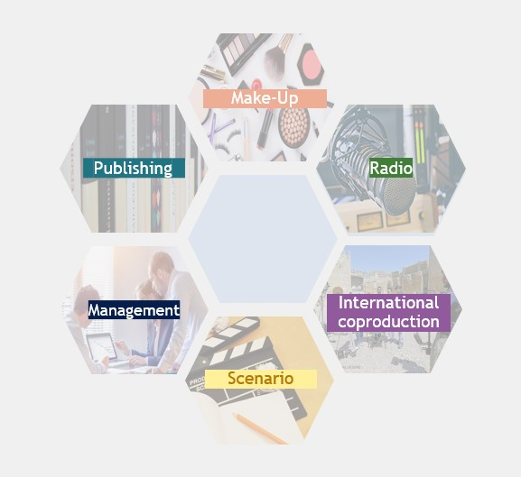
Our catalog
We benefit from strategic partnerships with Asfored, EMIC, La Fémis, Skillsday, etc., which give us access to a catalog of more than 500 training courses that we will digitize progressively
Our trainings
LAFAAAC now offers more than 50 training courses in 6 different fields
These trainings were created with the expert help of our partners and « localised » to fit with the needs of our targets in Africa
We will enrich this catalog with a minimum of twenty training courses per year and we aim to cover all the creative industries.

Slide 10
Our catalog
We benefit from strategic partnerships with Asfored, EMIC, La Fémis, Skillsday, etc., which give us access to a catalog of more than 500 training courses that we will digitize progressively
LAFAAAC now offers more than 50 training courses in 6 different fields
These trainings were created with the expert help of our partners and « localised » to fit with the needs of our targets in Africa
We will enrich this catalog with a minimum of twenty training courses per year and we aim to cover all the creative industries.
Soon, we will have more trainings about musique, fashion and the entrepreneurial culture market
Our trainings

Slide 11
The details of our training
PARTENARIATS ⁰⁵
Our annual production is continuous and in search of permanent diversification to address the needs of the market
E-reputation: regaining control
Digital marketing
Learn the art of correction
From the idea to the creation of a publishing house
Dive into the world of comics
Discovering paper
…
The faded make-up
Preparing make-up for white men
Natural and sophisticated makeup
Preparing makeup for black women
To be a chief make-up artist on a set
Radio media in the 21st century
Information on the radio
Animate the 4 main types of radio programs
Rules and techniques of radio animation
Practice the different types of radio writing
The fundamentals of radio writing
Digital marketing
Succeed in commercial negotiations
Preparing your commercial pitch
Being a manager: acting and making others act
Digital management
Digital and branding
Digital at the service of retail
…
Being a producer and starting in co-production
Succeeding in international co-production contracts.
Elaborating a development budget and a quote
Financing your co-production
The character
The Bible
The episode
The scene
The screenwriter's tools
...

Slide 12
Our first results
17
Focus on our trainings in Nigeria :
The fundamentals of the serial script
A training of 50H to train script writers of Nollywood to write serial script.
10h of training on mobile
+
Online Classes
+
Face to face workshop
+
Testimonials from Nigerian experts
Lessor
Partners
120k€
of revenus
+300
registered students
90%
say the have skills

Slide 13
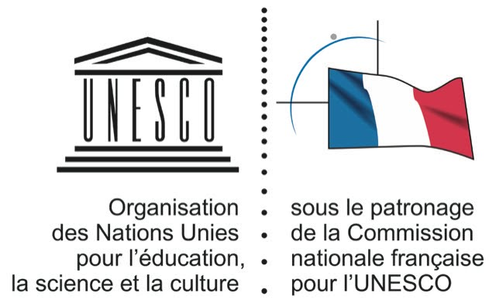
Our first operational and financial partners
SOUTIENS ¹⁰
Major audiovisual groups and major institutions have supported our search for financing and will contribute to our commercial development
01
Our first operational partners:
02
We are members of/supported by:
03
Our first financial supports:

Slide 14
To go further
For further information on LAFAAAC :
01
Olivier Pascal
CEO
+33 6 81 94 79 61
o.pascal@lafaaac.com
02
François Catala
Director of Pedagogy and Partnerships +33 6 64 41 78 31
f.catala@lafaaac.com
LAFAAAC, 24 rue de l’Est (c/o La Ruche) 75020 Paris
www.lafaaac.com

